Slide 1
Part II Review
Lecture Slides

Slide 2
Part II Review 1
Data analysis is the art of describing data using graphs and numerical summaries.
Chapter 10 commented on basic graphs, especially pie charts, bar graphs, and line graphs.
Chapters 11 to 13 showed how data analysis works by presenting statistical ideas and tools for describing the distribution of one variable.

Slide 3
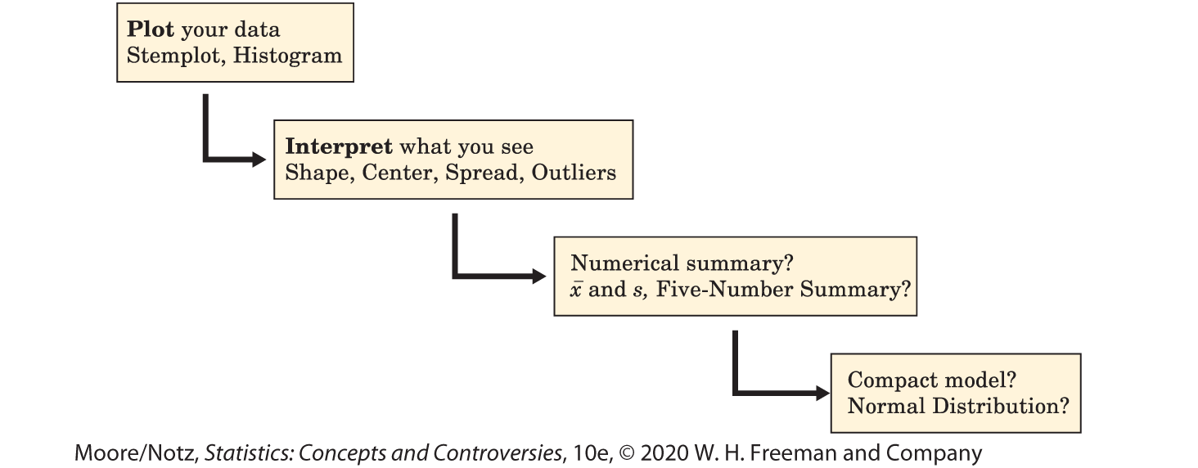
Part II Review 2
Figure II.1 organizes the big ideas.

Slide 4
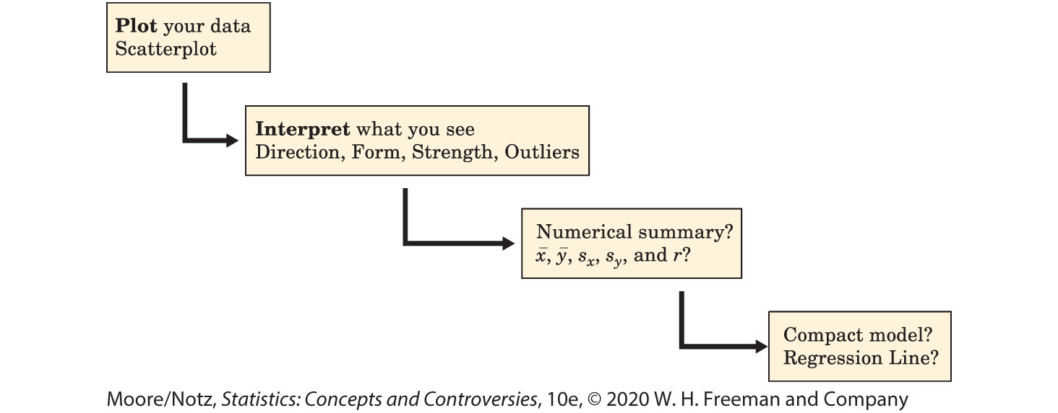
Part II Review 3
Figure II.2 retraces the big ideas from Figure II.1, with details that fit the new setting of Chapters 14 and 15 where we look at relationships between two quantitative variables.

Slide 5
Part II Review 4
In Chapter 16, we met a new kind of description, index numbers, with the Consumer Price Index as the leading example.
Chapter 16 also discussed government statistical offices, a quiet but important part of the statistical world.

Slide 6
Part II Review 5
DISPLAYING DISTRIBUTIONS
1. Recognize categorical and quantitative variables.
2. Recognize when a pie chart can and cannot be used.
3. Make a bar graph of the distribution of a categorical variable, or in general to compare related quantities.
4. Interpret pie charts and bar graphs.
5. Make a line graph of a quantitative variable over time.

Slide 7
Part II Review 6
DISPLAYING DISTRIBUTIONS (cont’d)
6. Recognize patterns such as trends and seasonal variation in line graphs.
7. Be aware of graphical abuses, especially pictograms and distorted scales in line graphs.
8. Make a histogram of the distribution of a quantitative variable.
9. Make a stemplot of the distribution of a small set of observations. Round data as needed to make an effective stemplot.

Slide 8
Part II Review 7
DESCRIBING DISTRIBUTIONS (QUANTITATIVE VARIABLE)
1. Look for the overall pattern of a histogram or stemplot and for major deviations from the pattern.
2. Assess from a histogram or stemplot whether the shape of a distribution is roughly symmetric, distinctly skewed, or neither. Assess whether the distribution has one or more major peaks.
3. Describe the overall pattern by giving numerical measures of center and spread in addition to a verbal description of shape.

Slide 9
Part II Review 8
DESCRIBING DISTRIBUTIONS (QUANTITATIVE VARIABLE) (cont’d)
4. Decide which measures of center and spread are more appropriate: the mean and standard deviation (especially for symmetric distributions) or the five-number summary (especially for skewed distributions).
5. Recognize outliers and give plausible explanations for them.

Slide 10
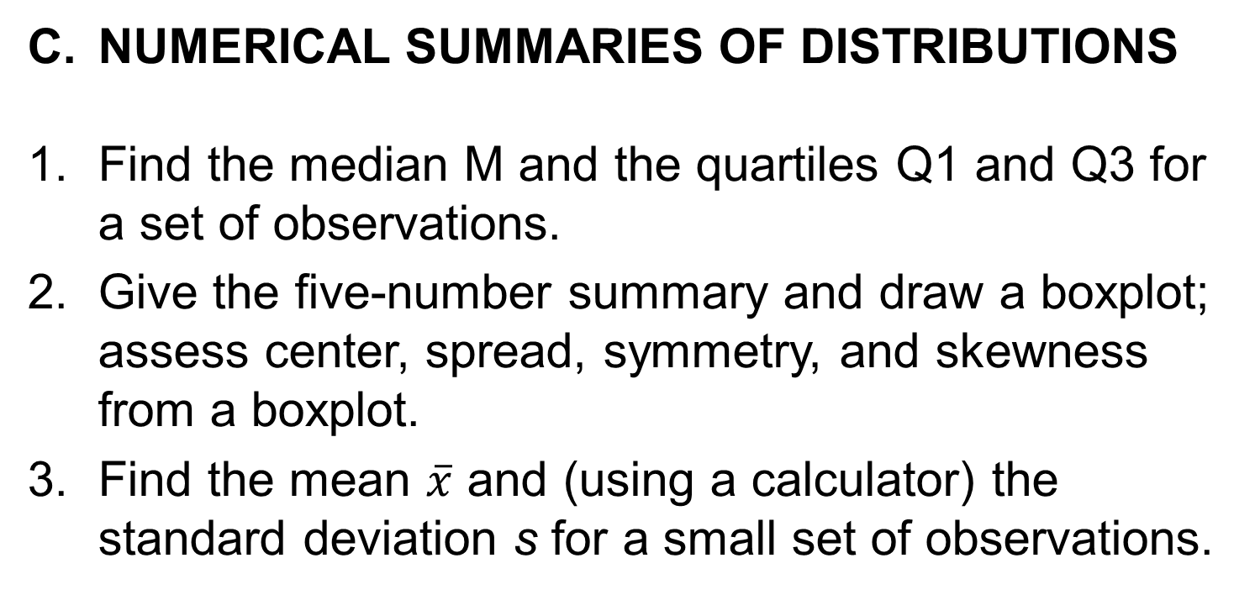
Part II Review 9
NUMERICAL SUMMARIES OF DISTRIBUTIONS
Find the median M and the quartiles Q1 and Q3 for a set of observations.
Give the five-number summary and draw a boxplot; assess center, spread, symmetry, and skewness from a boxplot.
Find the mean $\overline{x}$ and (using a calculator) the standard deviation s for a small set of observations.

Slide 11
Part II Review 10
NUMERICAL SUMMARIES OF DISTRIBUTIONS
4. Understand that the median is less affected by extreme observations than the mean. Recognize that skewness in a distribution moves the mean away from the median toward the long tail.
5. Know the basic properties of the standard deviation: s ≥ 0 always; s = 0 only when all observations are identical and increases as the spread increases; s has the same units as the original measurements; s is greatly increased by outliers or skewness.

Slide 12
Part II Review 11
NORMAL DISTRIBUTIONS
1. Interpret a density curve as a description of the distribution of a quantitative variable.
2. Recognize the shape of Normal curves, and estimate by eye both the mean and the standard deviation from such a curve.
3. Use the 68–95–99.7 rule and symmetry to state what percentage of the observations from a Normal distribution fall between two points when the points lie at the mean or one, two, or three standard deviations on either side of the mean.

Slide 13
Part II Review 12
NORMAL DISTRIBUTIONS (cont’d)
4. Find and interpret the standard score of an observation.
5. (Optional) Use Table B to find the percentile of a value from any Normal distribution and the value that corresponds to a given percentile

Slide 14
Part II Review 13
SCATTERPLOTS AND CORRELATION
1. Make a scatterplot to display the relationship between two quantitative variables measured on the same subjects. Place the explanatory variable (if any) on the horizontal scale of the plot.
2. Describe the direction, form, and strength of the overall pattern of a scatterplot. In particular, recognize positive or negative association and straight-line patterns. Recognize outliers in a scatterplot.

Slide 15
Part II Review 14
SCATTERPLOTS AND CORRELATION (cont’d)
3. Judge whether it is appropriate to use correlation to describe the relationship between two quantitative variables. Use a calculator to find the correlation r.
4. Know the basic properties of correlation: r measures the strength and direction of only straight-line relationships; r is always a number between −1 and 1; r = ±1 only for perfect straight-line relations; r moves away from 0 toward ±1 as the straight-line relation gets stronger.

Slide 16
Part II Review 15
REGRESSION LINES
1. Explain what the slope b and the intercept a mean in the equation y = a + bx of a straight line.
2. Draw a graph of the straight line when you are given its equation.
3. Use a regression line, given on a graph or as an equation, to predict y for a given x. Recognize the danger of prediction outside the range of the available data.

Slide 17
Part II Review 16
REGRESSION LINES (cont’d)
4. Use r², the square of the correlation, to describe how much of the variation in one variable can be accounted for by a straight-line relationship with another variable.

Slide 18
Part II Review 17
STATISTICS AND CAUSATION
1. Understand that an observed association can be due to direct causation, common response, or confounding.
2. Give plausible explanations for an observed association between two variables: direct cause and effect, the influence of lurking variables, or both.
3. Assess the strength of statistical evidence for a claim of causation, especially when experiments are not possible.

Slide 19
Part II Review 18
THE CONSUMER PRICE INDEX AND RELATED TOPICS
1. Calculate and interpret index numbers.
2. Calculate a fixed market basket price index for a small market basket.
3. Use the CPI to compare the buying power of dollar amounts from different years. Explain phrases such as real income.

